Slide 1


Money In Education
Pamela Vargas
Ysatis Tagle
Rekik Worku

Slide 2
Purpose/Research Question
Does state per pupil funding and the average household income of students have a relationship with student performance on standardized tests?
Motivation
This information is important because it could have impact on the academic progress and the resources available for many students
Notes:
Script: Looking at per pupil funding hints at the disparity between public schools in the United States and the opportunities that can be available to students. One way to look at how funding is distributed is through the average household income of residents in each state. So for the purpose of this project, we wanted to see if state per pupil funding and average household income of students have a relationship with student performance on standardized scores.

Slide 3
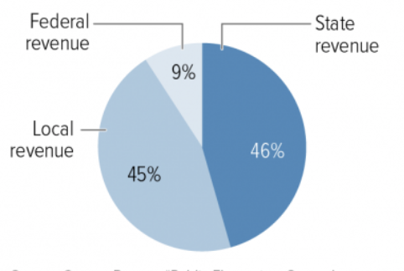
Background
Since public schools are dependent on local property taxes for a considerable amount of their funding, often more affluent or high-wealth/income districts receive more per pupil funding than low-wealth/income districts.
Federal funding to low-income Title I schools has decreased since 2010
Notes:
Funding to low-income Title I schools has decreased since 2010. Since public schools are dependent on local property taxes for a considerable amount of their funding, often more affluent or high-wealth/income districts receive more funding than low-wealth/income districts. This difference in funding can impact factors like class retention rates, the classes that are being taught in schools (having advanced or college-preparedness courses), and schools’ ability to hire and keep good teachers to educate and even mentor students.

Slide 4


What test scores are we using?
-Only standardized test that measures student progress nationally
-NAEP/NEA Math and English/Language Arts (ELA) scores
-Has information about how students in public schools are performing academically
Notes:
Since we are looking at the entire US, we decided to use N.A.E.P. which is the “only assessment that measures what U.S. students know and can do in various subjects across the nation, states, and in some urban districts”. Every different state has its own test so this standardized test and this test allows us to get a sense of students progress in standardized tests between states.

Slide 5
Where did our data come from?
-National Center for Education Statistics
-2015 Annual Survey of School System Finances, U.S. Census Bureau
Cases:
50 States + District of Columbia (51 cases)
Variables:
-Average Test score (0-500 pts) Math test (Continuous quantitative)
-Average Test score (0-500 pts) ELA test (Continuous quantitative)
-Median Household Income
-Per Pupil Spending
-Projected Student Enrollment
Notes:
We got our data from the National Center for Education Statistics and 2015 Annual Survey of School System Finances, U.S Census Bureau. Our cases are the 50 states + district Of Columbia . Our variables are the average test score (math test and reading scores) which are the response variables and , median household income, per pupil spending, which are the explanatory variable. Our last variable is the project student enrollment. None of our variables could have been controlled.

Slide 6
Methods
Regression Model
Multiple Regression of Median Household Income and Average NEA reading/math scores
Multiple Regression of State Per Pupil Funding and Average NEA reading/math scores
Hypothesis test analysis
Notes:
Pamela : We decided to use the multiple regression model, which gave us a hypothesis test analysis,.

Slide 7
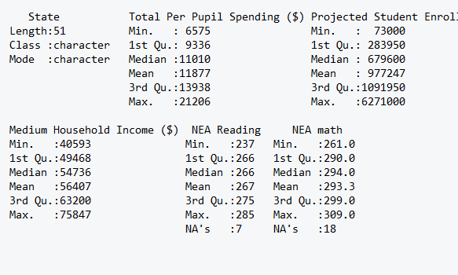
Summary Statistics
Notes:
Pamela:Here is our summary statistics data table. I want to draw attention to our interquartile range for the NEA Reading scores, which show a difference of 9 points. This means that 50 percent of our data is fairly homogeneous compared to the lower twenty-five percent of data has a spread of 30 points. Because the way this data is spread between the quartiles, we experienced a lot of outliers that drastically impacted our results.

Slide 8
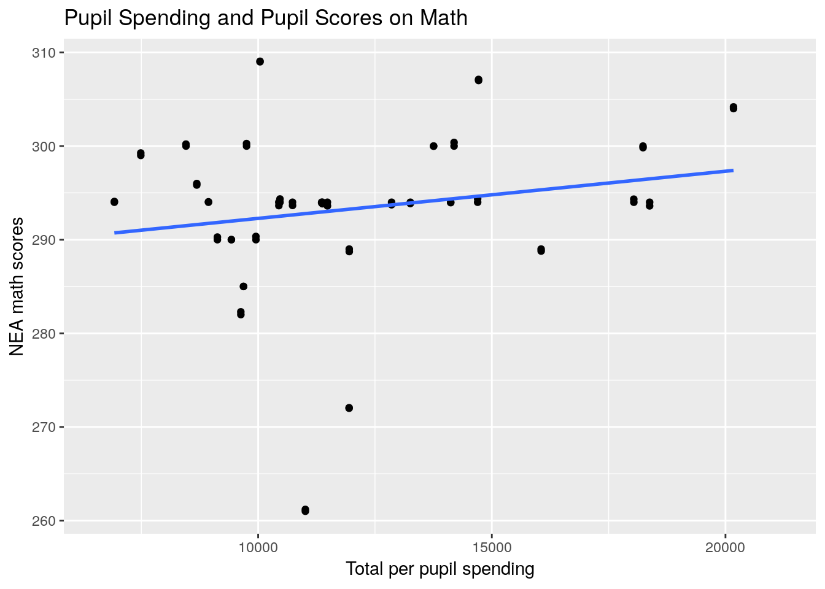
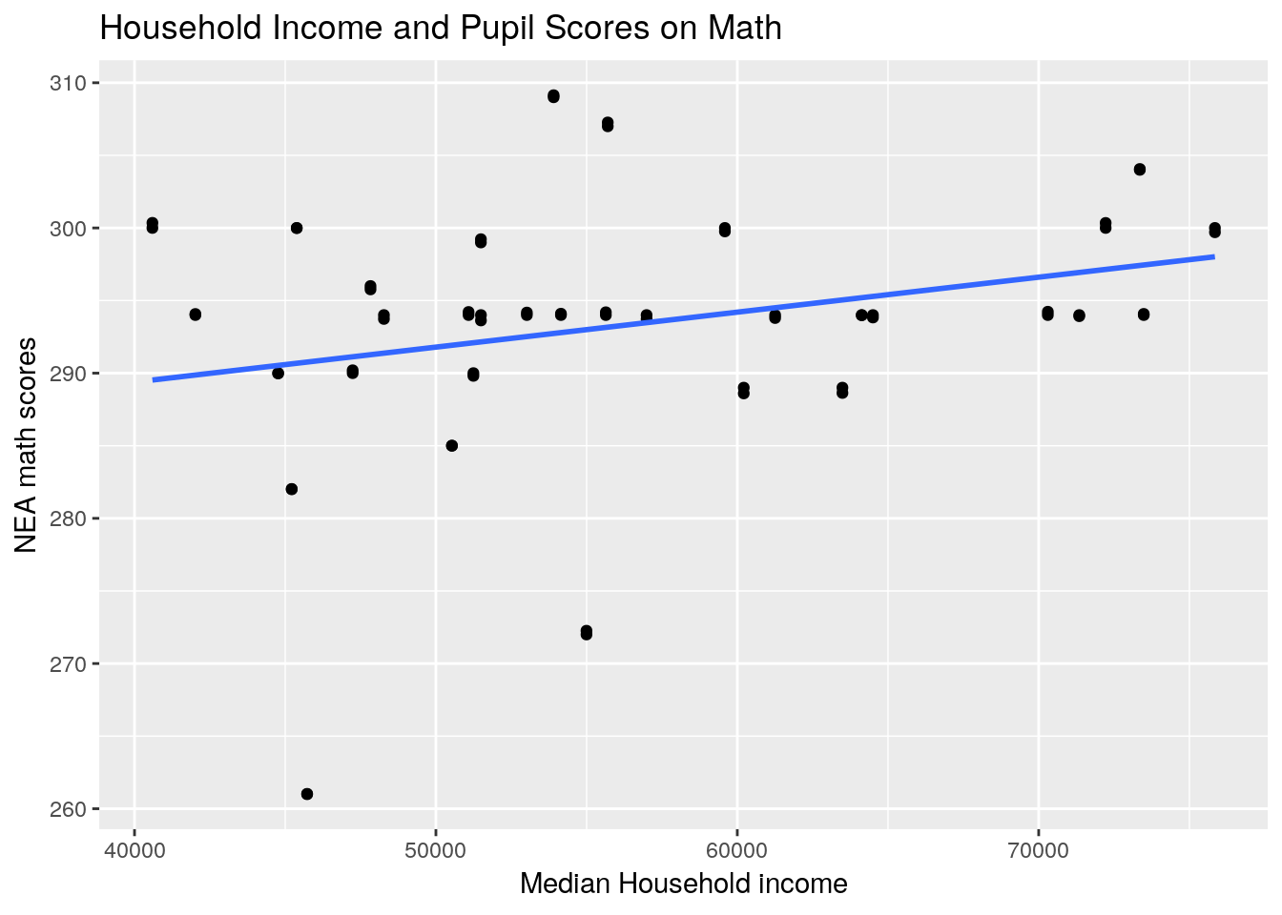
Results
Notes:
Pamela:We created regression graphs. As I just pointed out, you can see that there are a lot of outliers. We tried to filter some of the outliers, but found ourselves in the same position because there were still outliers present. It made no statistically significance difference in our results and decreased the number of observations, which were already limited.

Slide 9
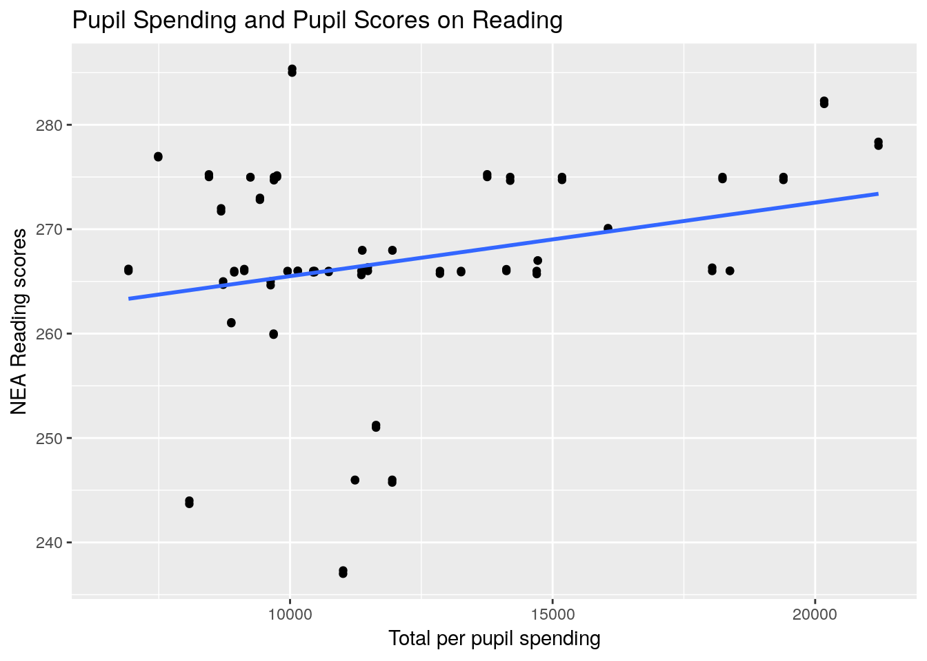
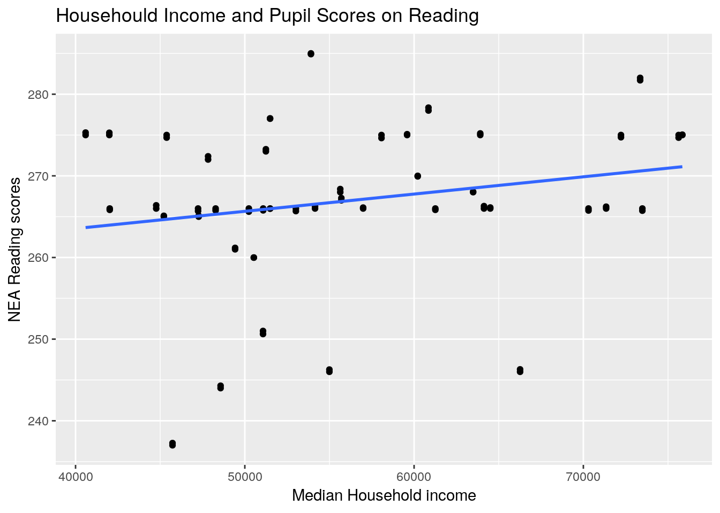
Results contd.
Per Pupil Spending
Notes:
We would like to point out the graph on the right. There is a positive weak trend between pupil spending and Reading score which means that as the amount of pupil funding increases so does the reading score, but we can not make a definitive inferences because of other statistical factors, which Ysatis will explain further.

Slide 10
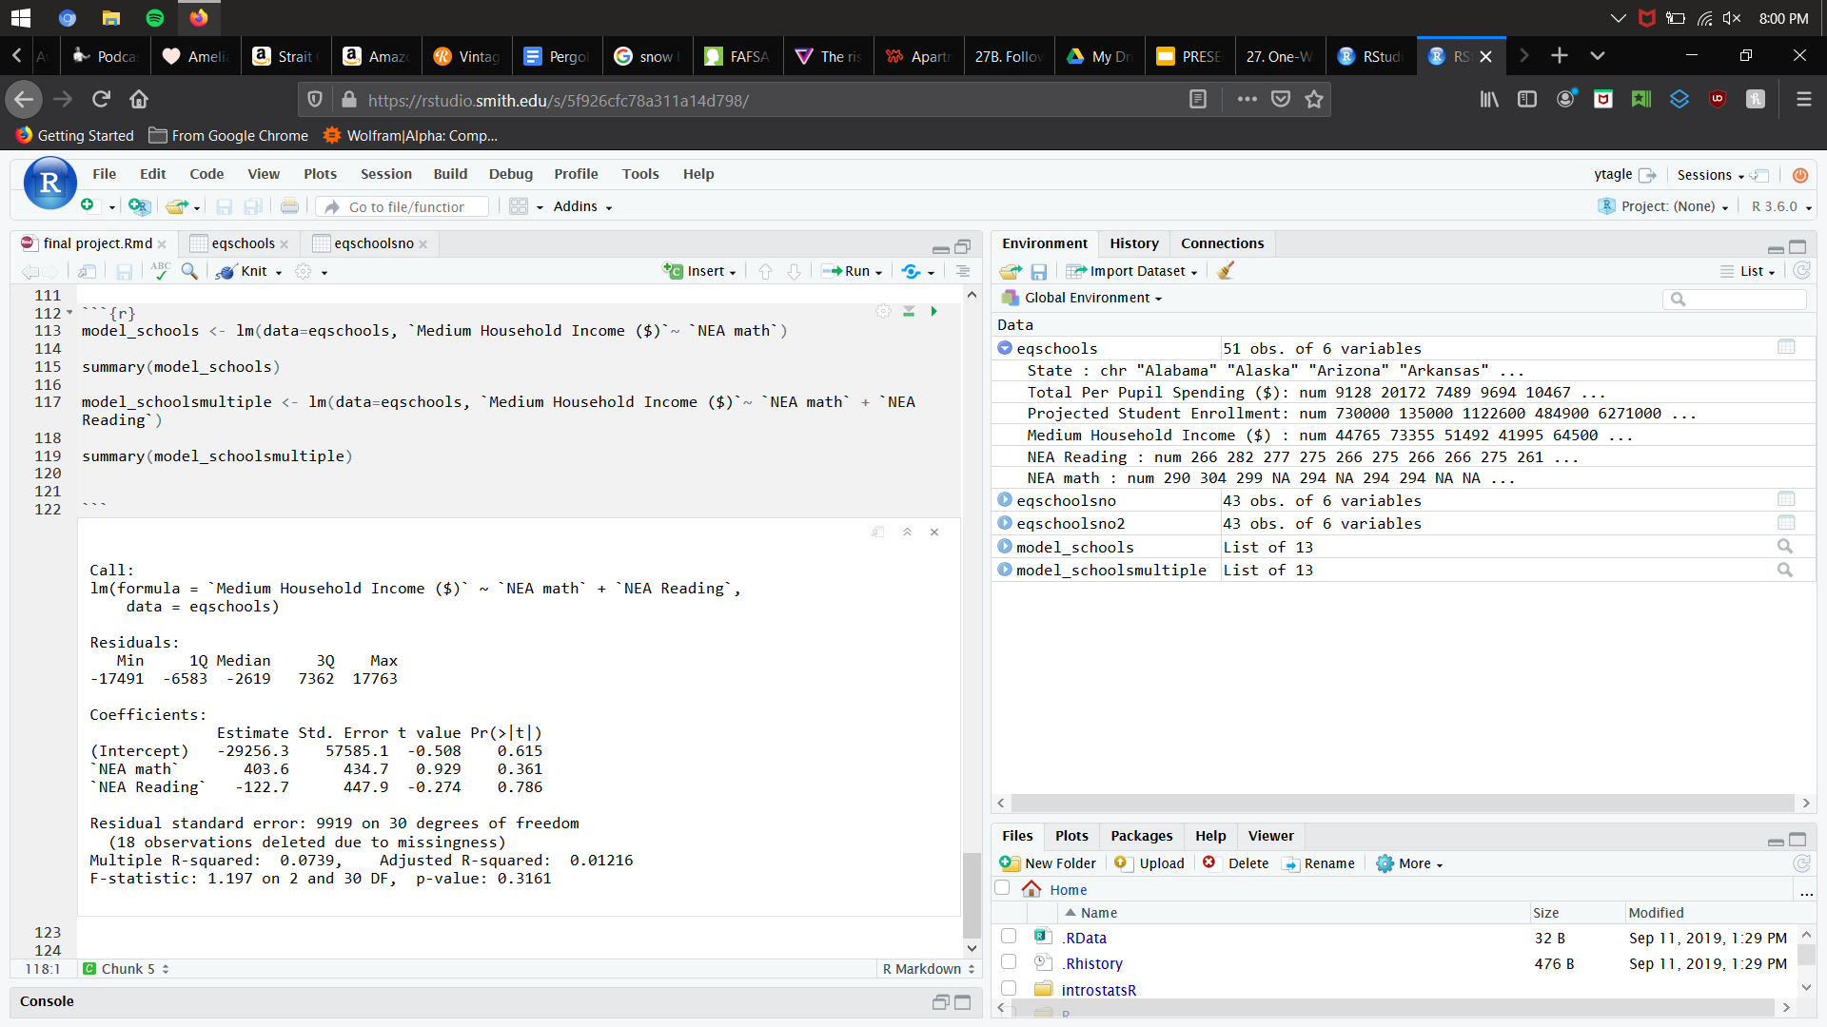
Results contd.
Did not meet conditions
Not statistically significant
~30 Cases
Fail to reject the null
Notes:
Ysatis: This is one of our multiple regression models. We decided to run one as the graph before hinted at a relationship, but even so.. Our data did not meet the conditions for a multiple regression model. There are so many outliers and there is not equal variance as we saw in the slide before. All of them were not statistically significant, as our significance level is .05 and our P-value even here is way higher. Even if it was significant, all our models were slightly above 30 cases which is the minimum number of cases we would need for this to be valid. We thus fail to reject the null and can not conclude that Math scores and income are related. This is reflected in our high P-value and low r squared values.

Slide 11
Limitations/Assumptions
Limitation: Number of cases (N/a)
Assumption: 2015 only, US focused, NEAP.
For future work, it would be better to focus more intently on a smaller region with more cases.
Notes:
One major limitation of our data is the number of cases. This limitation is reflected in our results. Our data is also based on 2015, US scores for the NEAP, which with our question, we are assuming these three factors are universal. For future work, it would be better to focus more intently on smaller regions with more cases such as districts, zip codes, or cities.

Slide 12
Discussion
Relationship? (Chart vs regression results)
Not enough data for conclusions
Limitations: Spread, few cases.
Problems: N/a, uneven variability, and outliers.
Question: Districts focus?
Ideals: Missing cases, and other time of variables.
Notes:
We cannot say that there is or isn’t a relationship between average household income and per pupil spending with this given data.
We can tell that there might be a relationship between scores as shown in our regression charts, but our multiple regression results do not confirm whether there is or not. We didn’t have enough data to really draw any personal revelations or conclusions. Our major problems are simply due to the spread of our data, and how few cases we have to really show the relationships. Problems include N/A points, uneven variability, and outliers. Some questions we have is what our data would look like if we focused on districts. That includes missing cases, also test scores over time and change.

Slide 13
Questions?

Slide 14
References
10, et al. “Poverty and School Funding: Why Low-Income Students Often Suffer.” The Edvocate, 15 Jan. 2017, www.theedadvocate.org/poverty-and-school-funding-why-low-income-students-often-suffer/.
Governing. (2018, June 1). Education Spending Per Student by State. Retrieved November 3, 2019, from https://www.governing.com/gov-data/education-data/state-education-spending-per-pupil-data.html.
Camera, Lauren. “In Most States, Poorest School Districts Get Less Funding.” U.S. News & World Report, U.S. News & World Report, 27 Feb. 2018, www.usnews.com/news/best-states/articles/2018-02-27/in-most-states-poorest-school-districts-get-less-funding.
Chingos, Matthew, and Kristin Blagg. “Making Sense of State School Funding Policy.” Making Sense of State School Funding Policy, 2017.
“Federal Role in Education” Home, US Department of Education (ED), 25 May 2017, www2.ed.gov/about/overview/fed/role.html.
Thank you so much!

